Slide 1

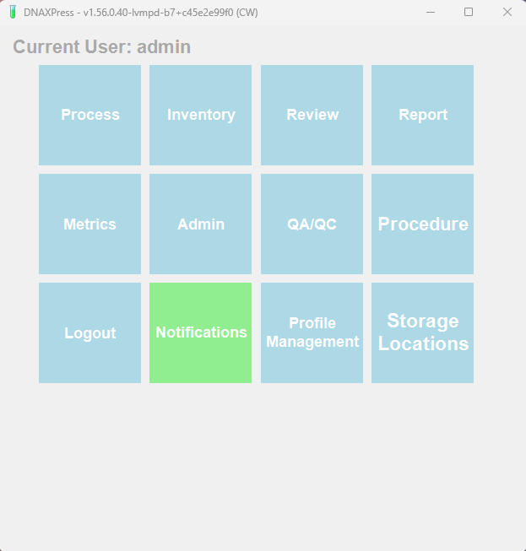
A Modular Designed Computer Assisted DNA Sample Information Management and Quality Assurance System
Notes:
DNAXpress was design by actual DNA Analysts to be a laboratory assist to relieve some of the tedious and redundant work common in DNA sample typing to allow their experience and expertise to be applied to more cognitively demanding issues.

Slide 2
Critical Design Elements of DNAXPRESS
Modular Design patterned after a Smart Device
Solution Agnostic –STRs, MPS, research, etc.
Flexible and Adaptable to accommodate your current workflow
Intuitive User Interface
Designed with the focus on the Scientist and the Science
Cost Effective

Slide 3
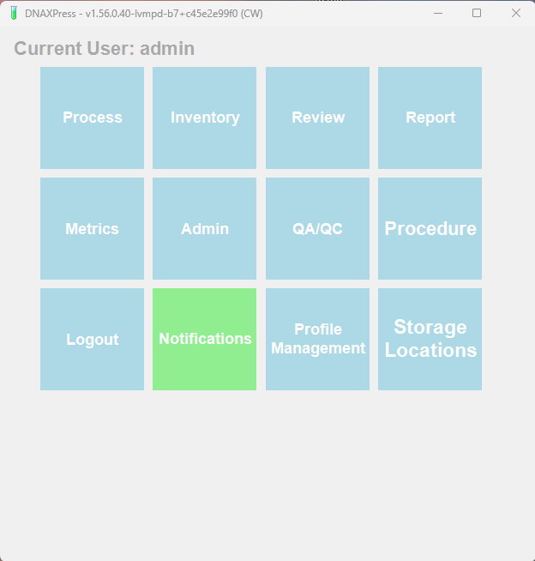

Slide 4
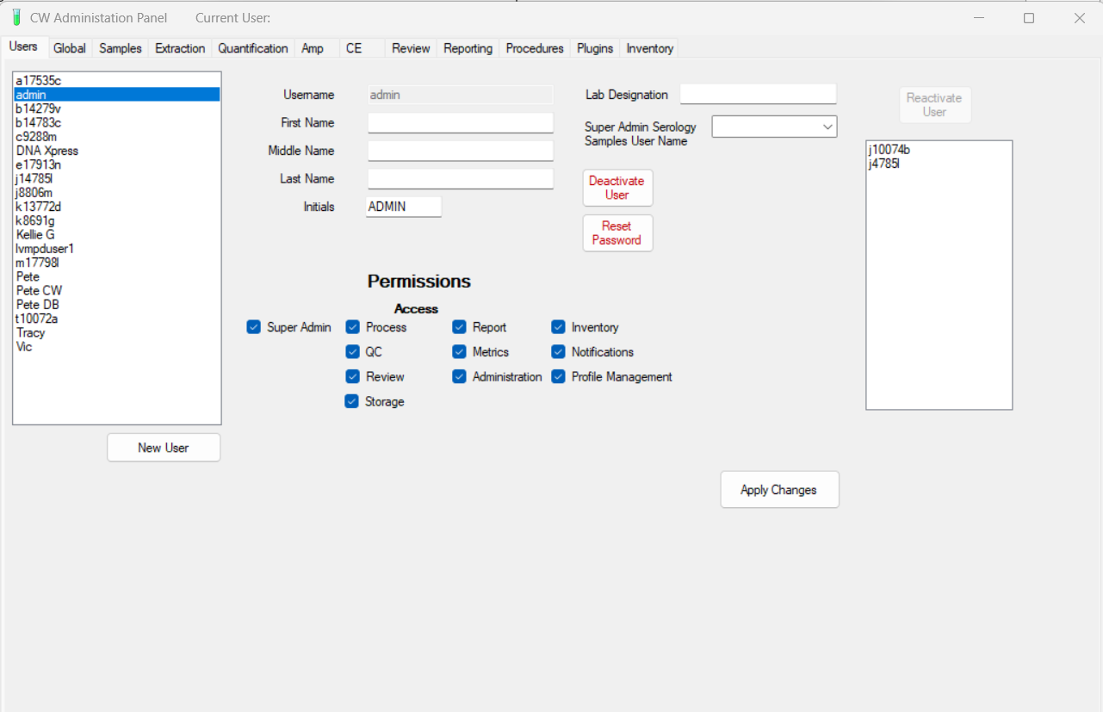

Slide 5
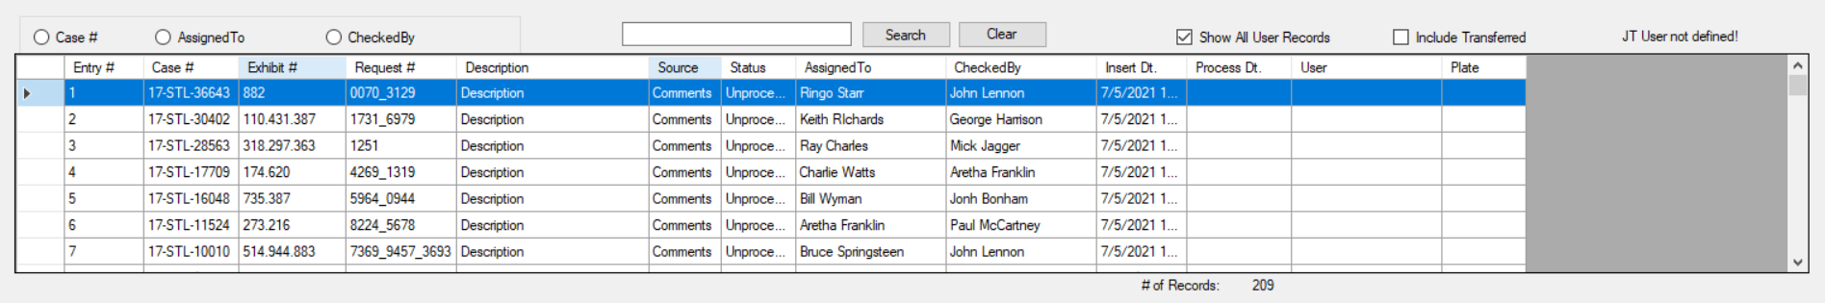
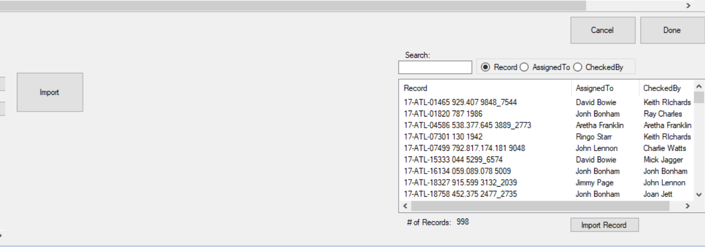
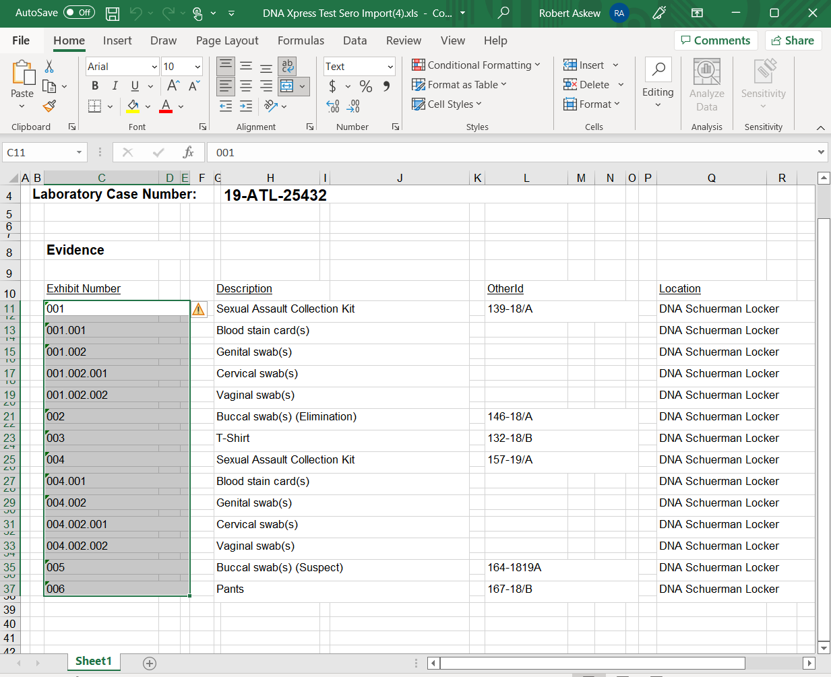
Compatible with Internal DB, External DB or Delimited Files

Slide 6
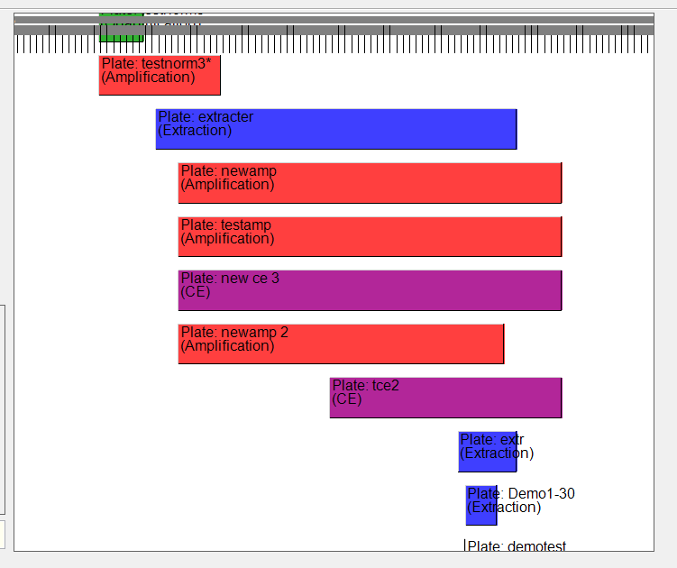
Dynamic Timeline Plate Level View

Slide 7
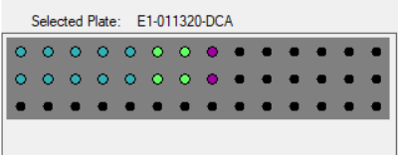
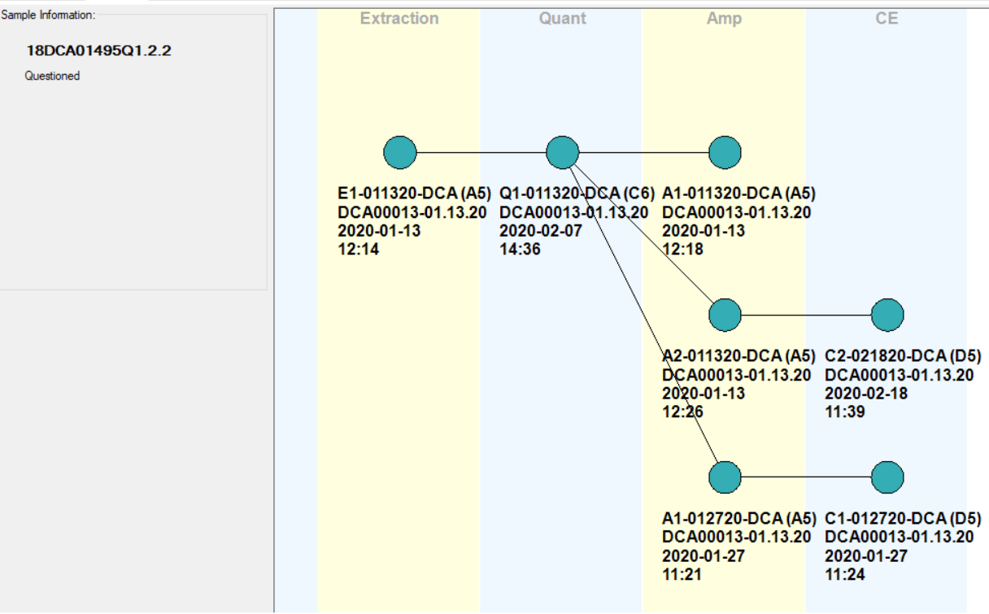
Complex sample process pathways
Entire sample process pathway(s) can be seen by clicking on any sample well on any plate in the sample’s history
Notes:
A visual map (tree) of the sample process pathway is drawn in real time as a sample moves trough the process paradigm. This is a very useful for both troubleshooting as well as sample metrics. In forensics we very rarely see a linear process pathway. We deal with things like differentials, replicates and compromised samples on a regular basis.

Slide 8
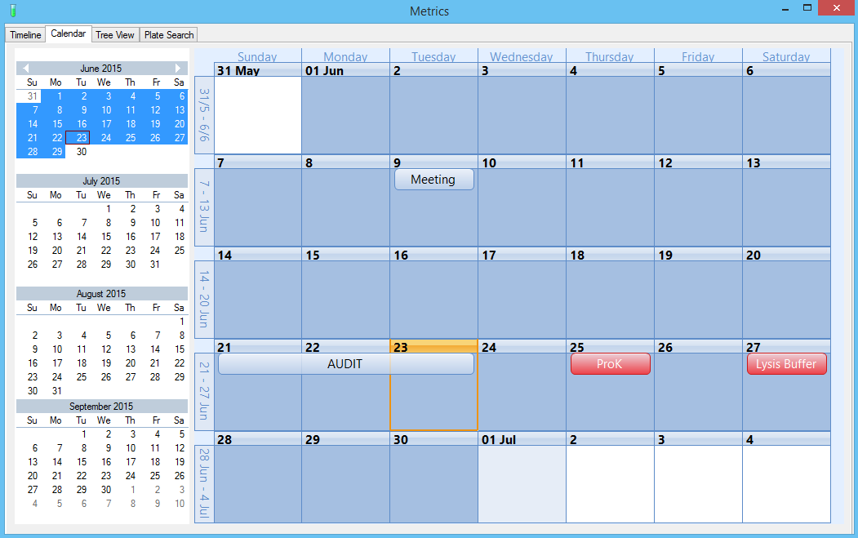
Integrated Calendar
displays all relevant QA\QC and allows for custom event scheduling

Slide 9
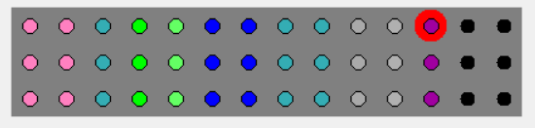

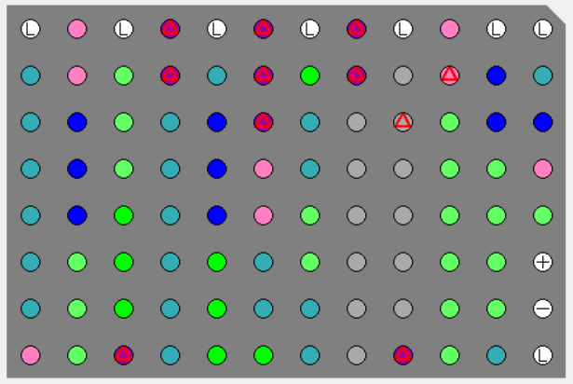
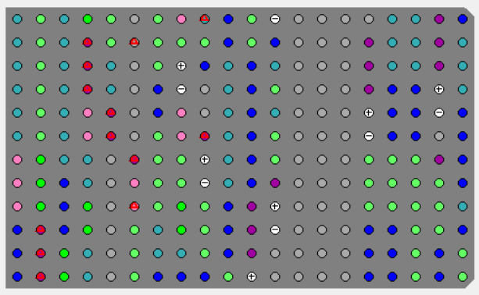
Completely customizable plate sizes
Strips
Tube Racks
96 Well Plates
High Capacity
Notes:
One of the more unique aspects of DNAXpress is that it allows you to transfer and combine sample from any plate size from single capacity tubes to 384 well plate. It even allows you to make custom sized plates for specialized applications. This feature becomes very important in a rapidly changing testing environment.

Slide 10
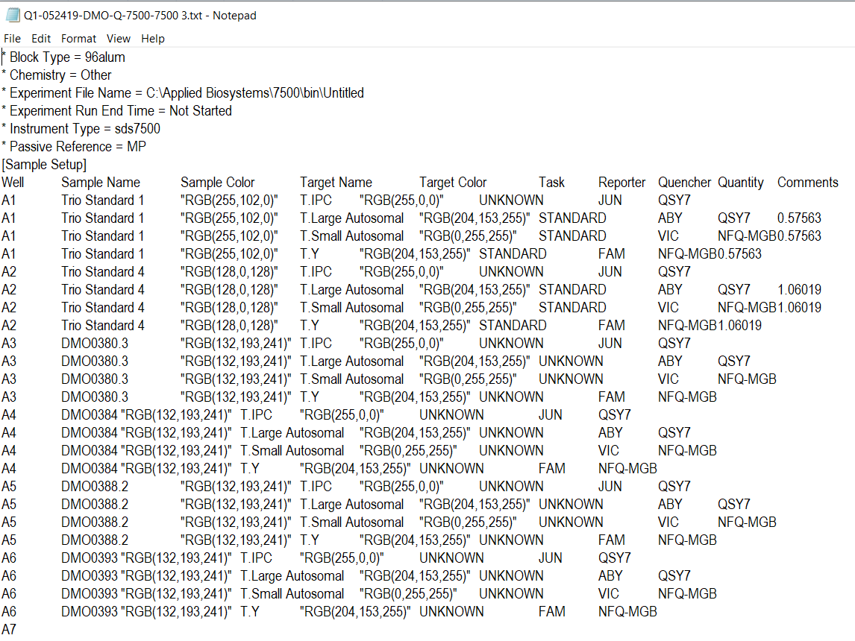
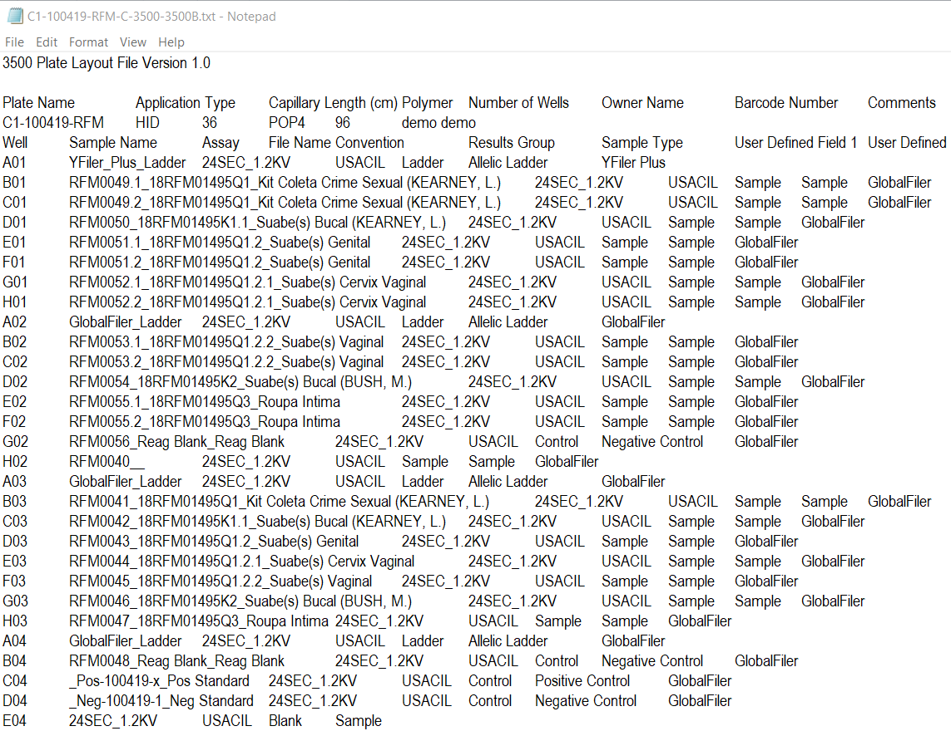
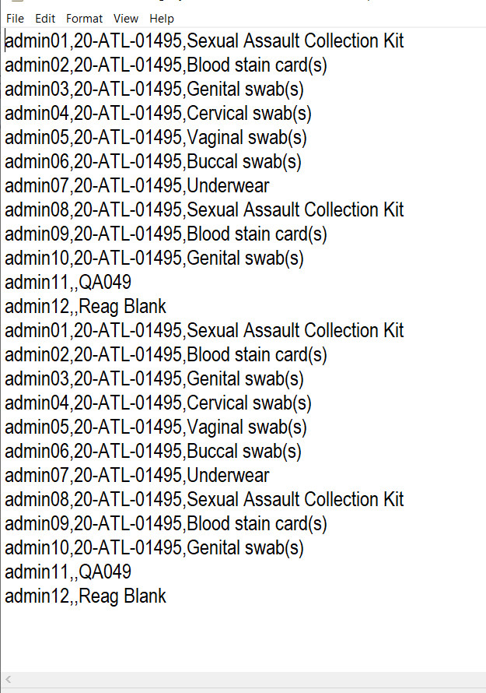
Instrument Communication/Integration
Quantification (7500)
Electrophoresis (3500)
Liquid Handlers (QiA)

Slide 11
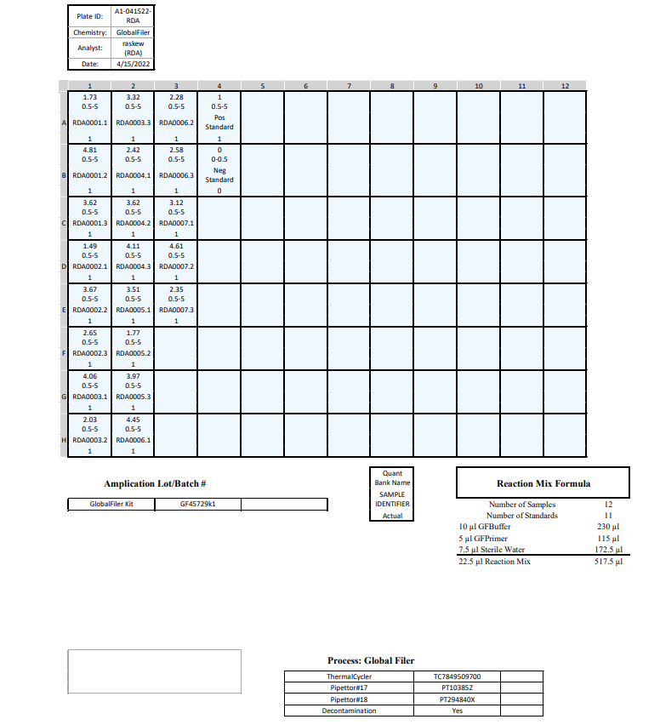
Printable Plate Views

Slide 12
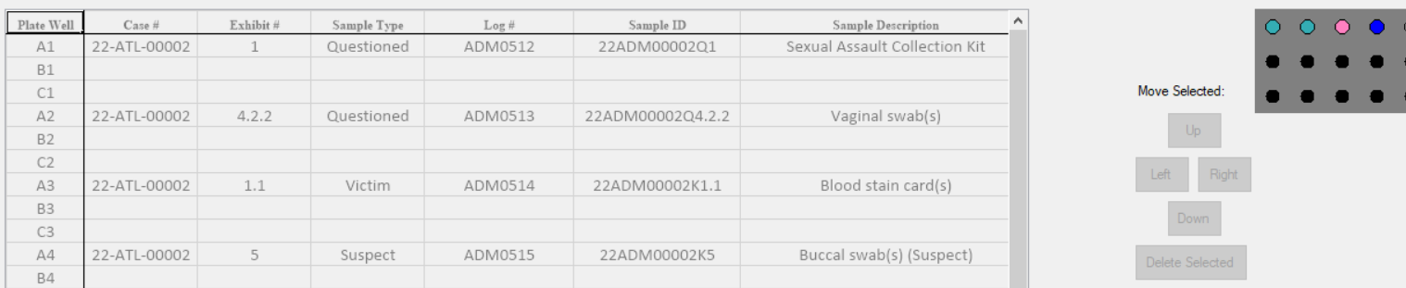
DNAXPRESS uses two Unique Keys to Identify Samples via integrated Parser

Slide 13
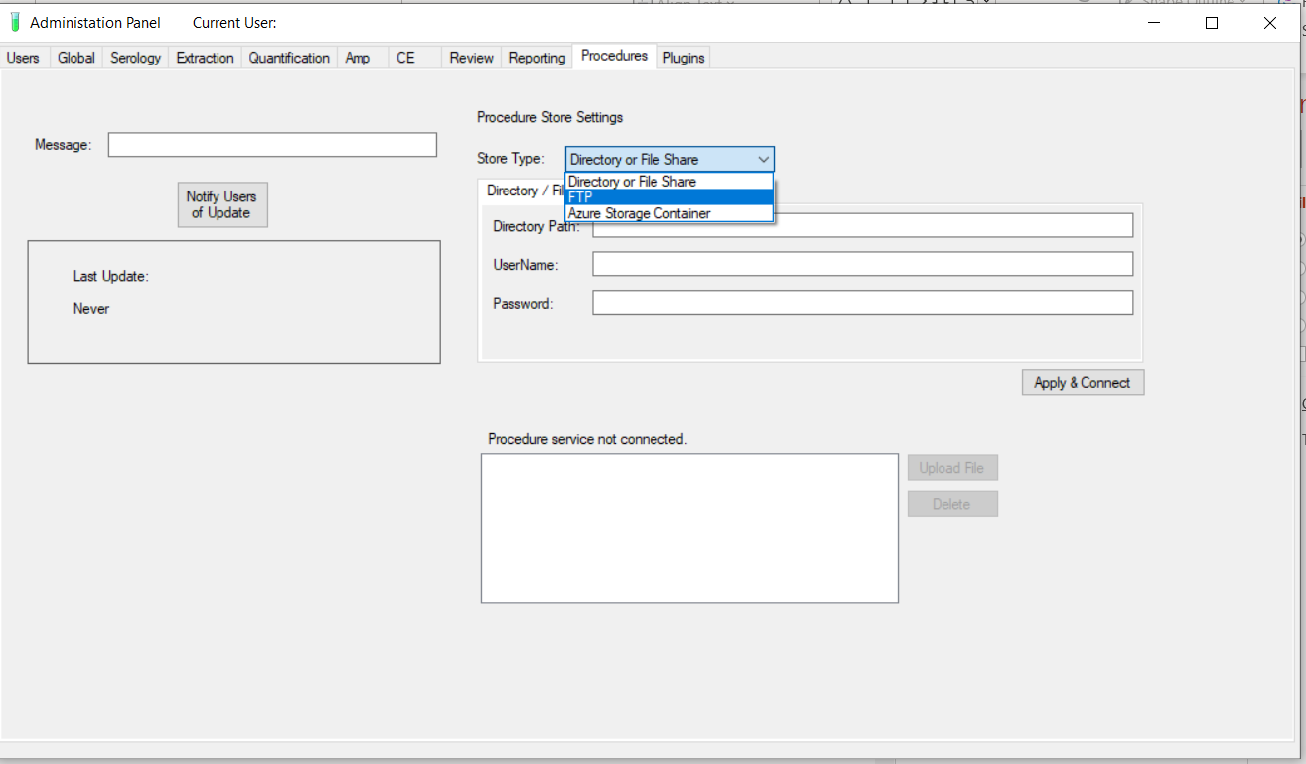
Integrated Document Storage

Slide 14
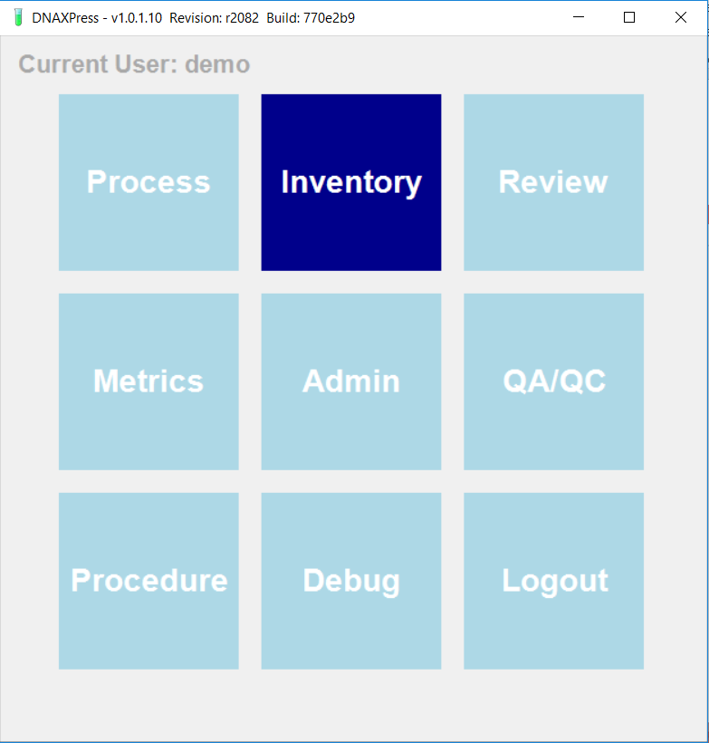

Slide 15
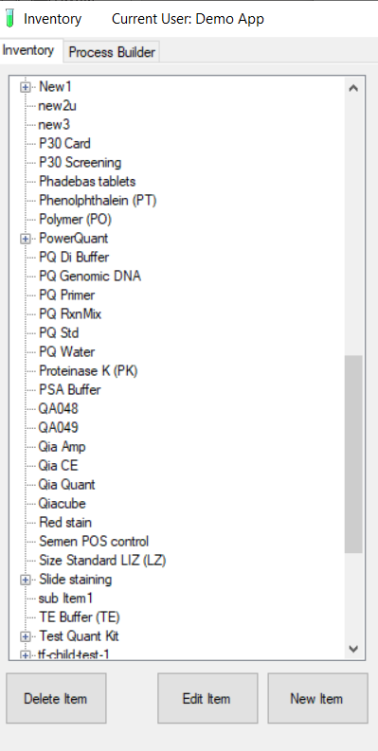

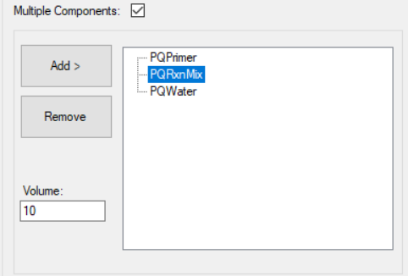
Layered Inventory
Individual kits and paradigms can be adjusted to the types of samples being received without affecting previous analysis
Simple interface doesn’t require significant computer programming skills to adjust. Simply Drag and Drop.
Allows you to create any number of process templates and use them in any combination
Reaction Mix calculation feature allows instant and precise Master Mix calculations to performed as integral part of workflow

Slide 16
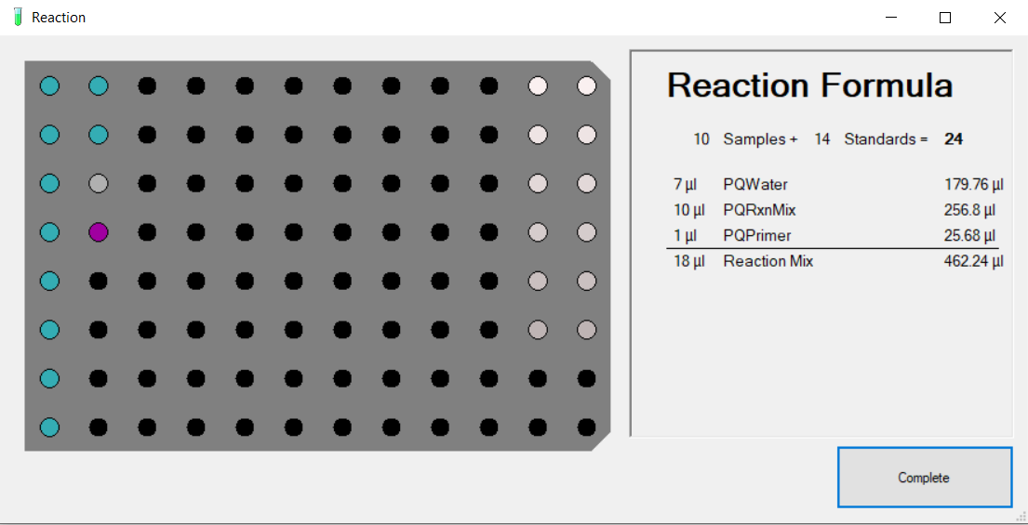
Auto RxnMix Calculations downstream in Process Tile

Slide 17
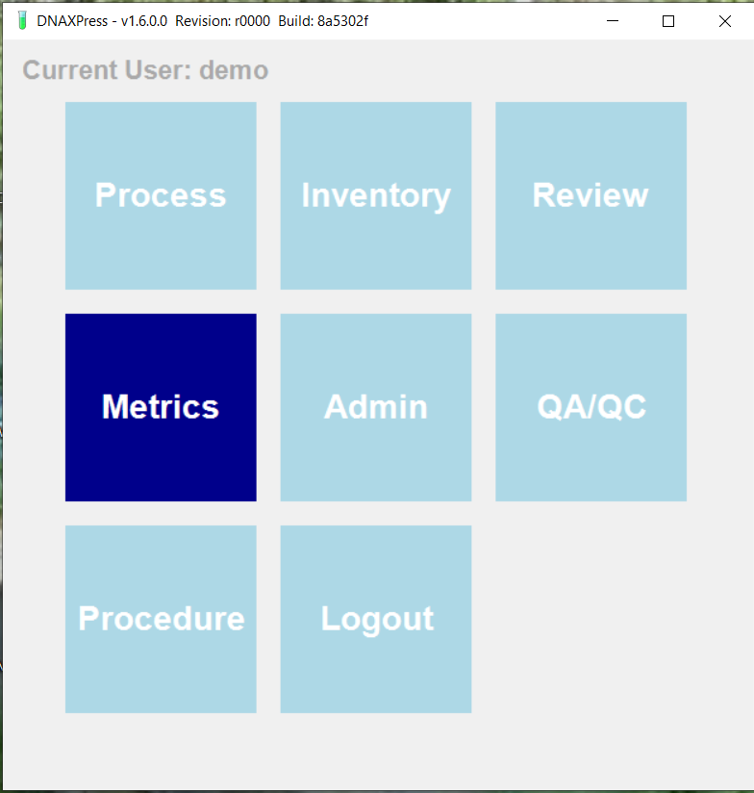

Slide 18
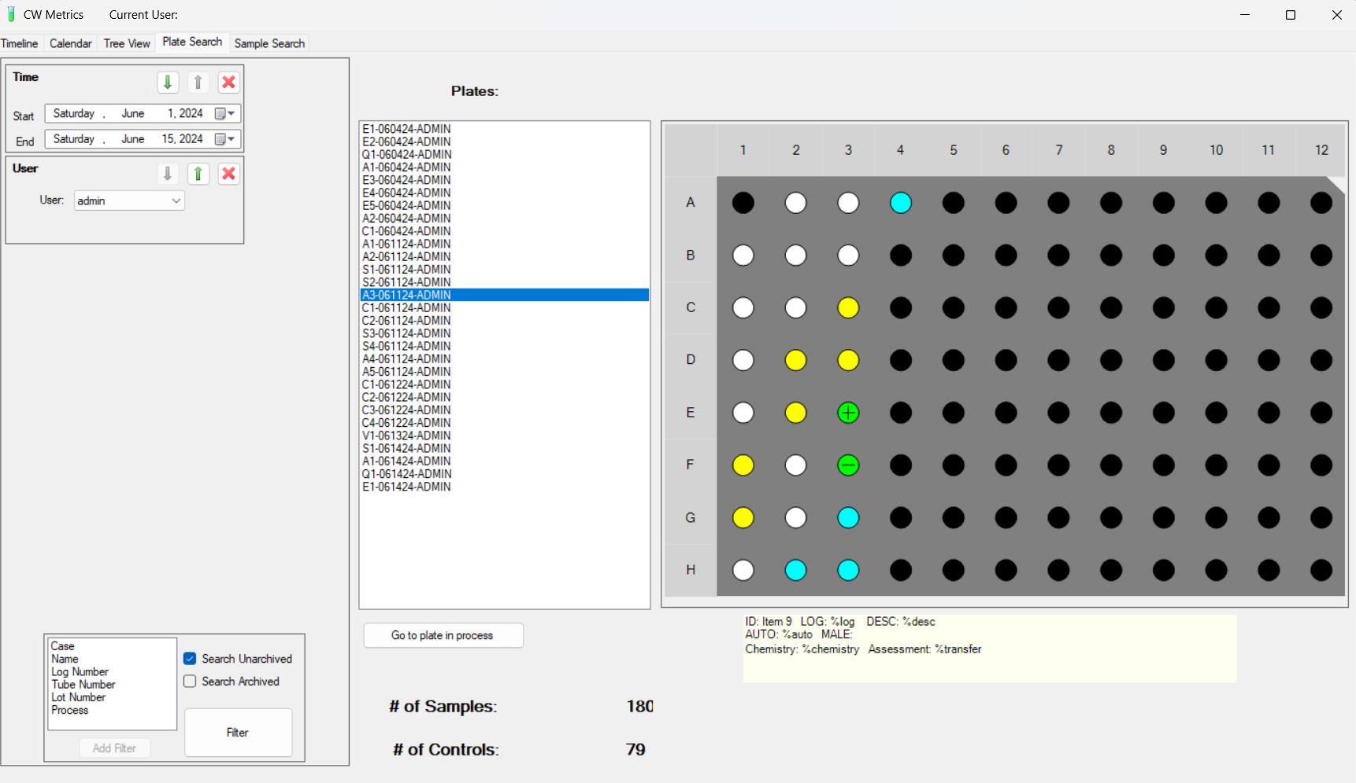
Robust Metrics Engine

Slide 19
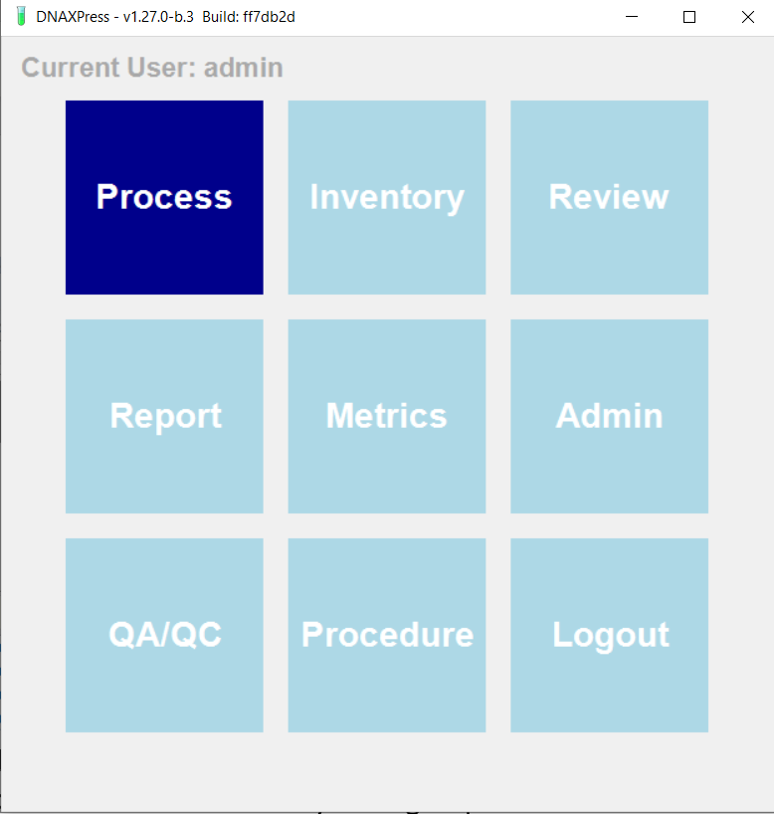

Slide 20
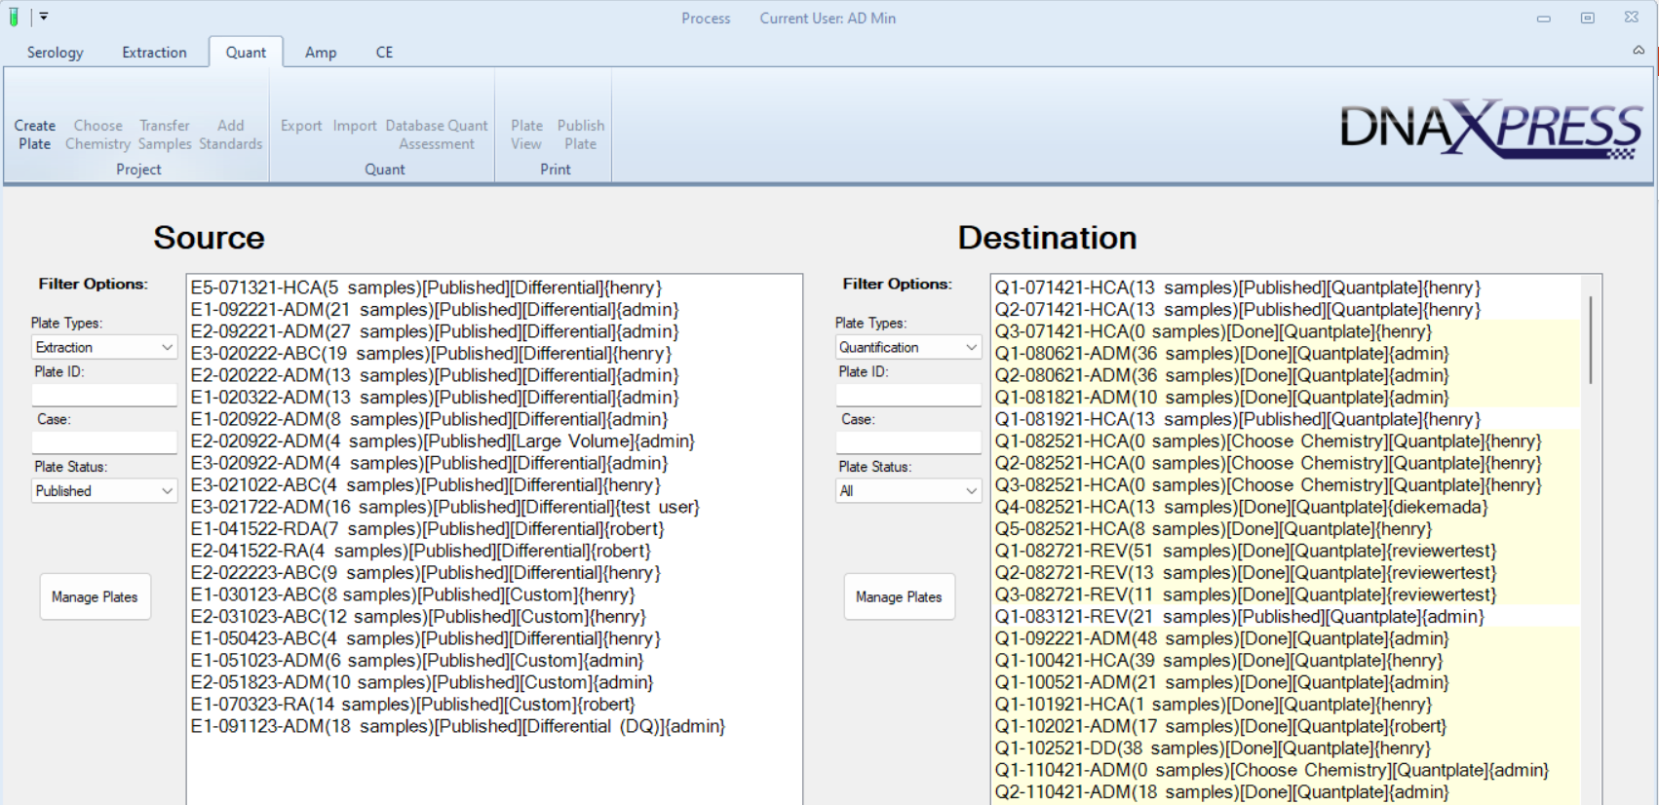
Plate Stacks in each Phase

Slide 21
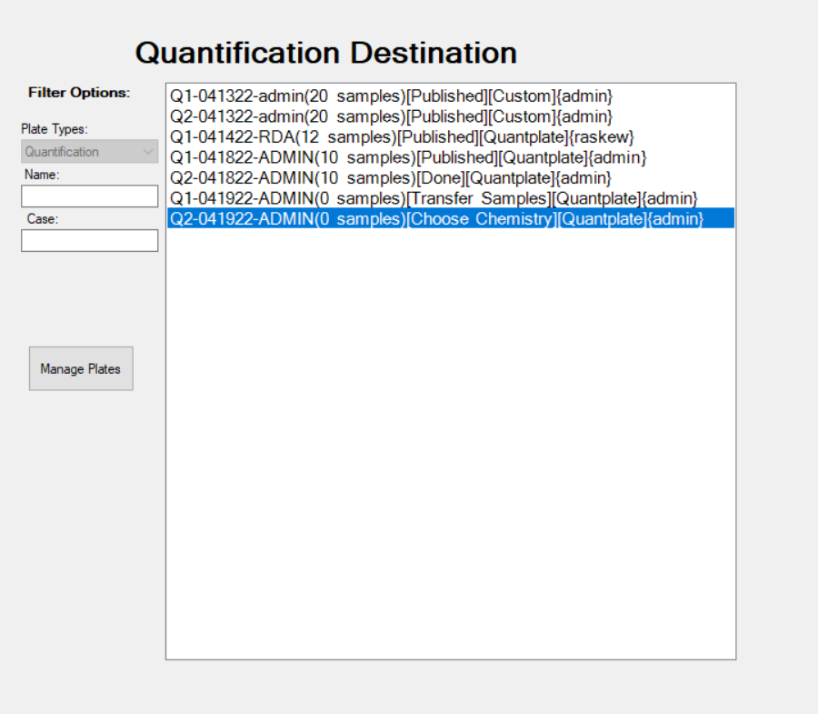
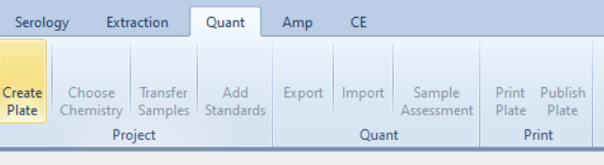
Workflow Manager

Slide 22
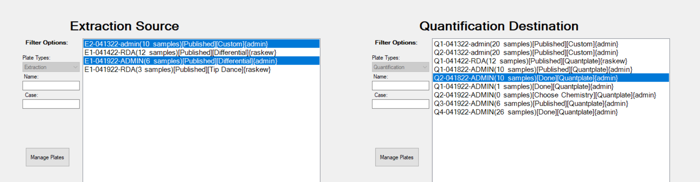
Source(s) and Destinations(s)

Slide 23
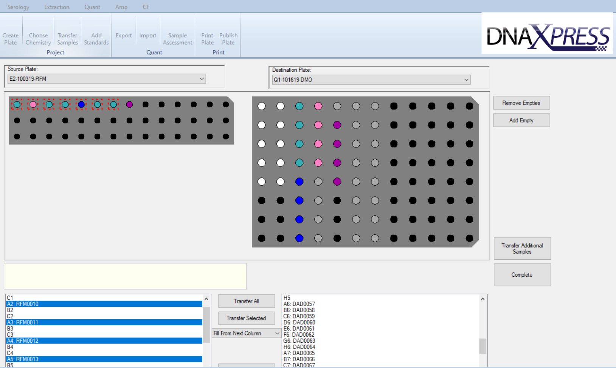
Transfer Window
Combine any number, shape, and size of plates. Samples can be transferred individually or as groups.

Slide 24
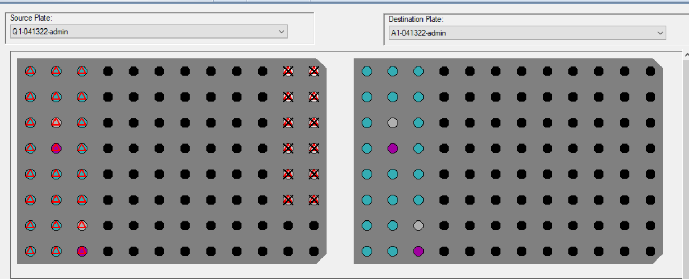
Quality vs Policy Rule Umbrella

Slide 25
Some Examples of Rule Firings
Policy X
  Missing Controls
  Mismatched Import
  Amp chem doesn’t match assessment
  Assessment required
  Sample requires review
  Advance only Published Plates
  Expired Reagents
Quality
  Check IPC
  Curves Checks
  Autosomal Low
  Y Low
  Elevated Auto/Y ratio
  Notes Added
  Documentation Incomplete
  Expired Reagents

Slide 26
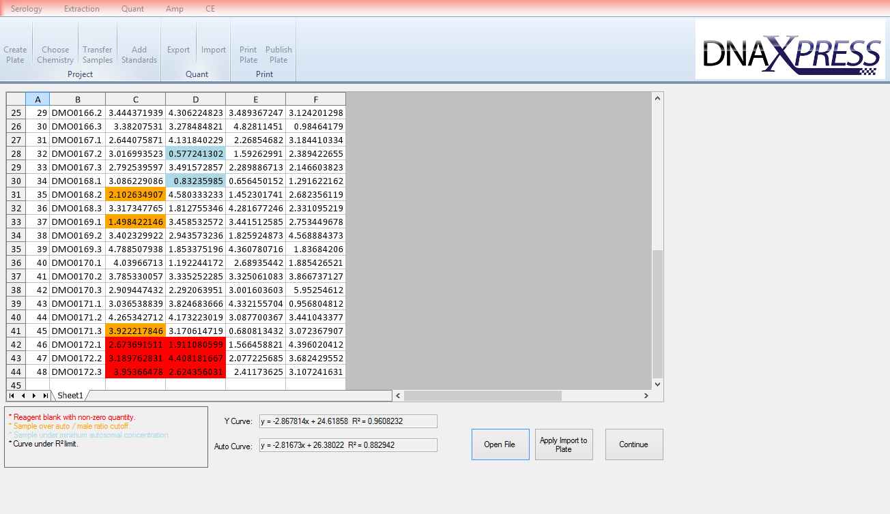
Automated Quality Control Alerts Ensure Quality of Results and Saves Valuable Analyst Time
Notes:
The system applies a complex set of user defined Quality Rules and automatically checks all the data to identify potentially problematic data.

Slide 27
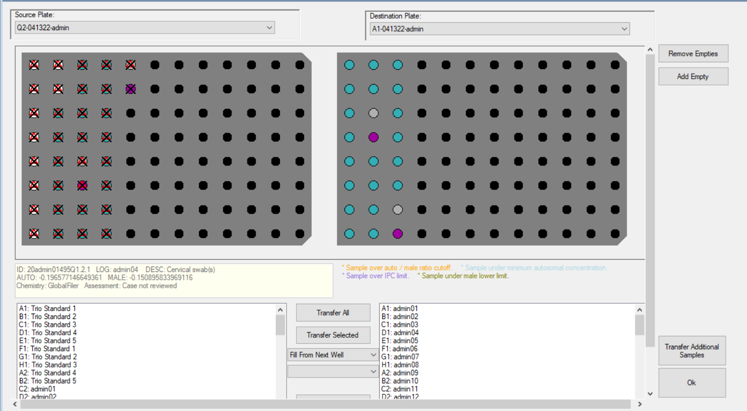

Slide 28
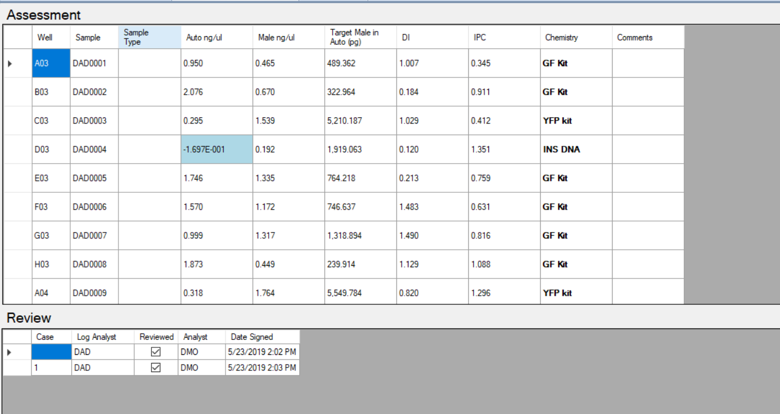
Higher Level Logic Computer Assisted Sample Assessment

Slide 29
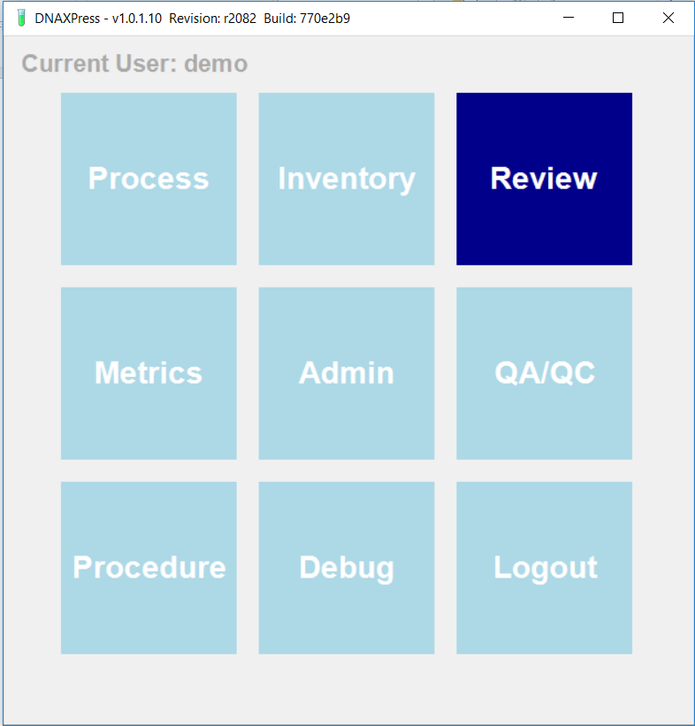

Slide 30
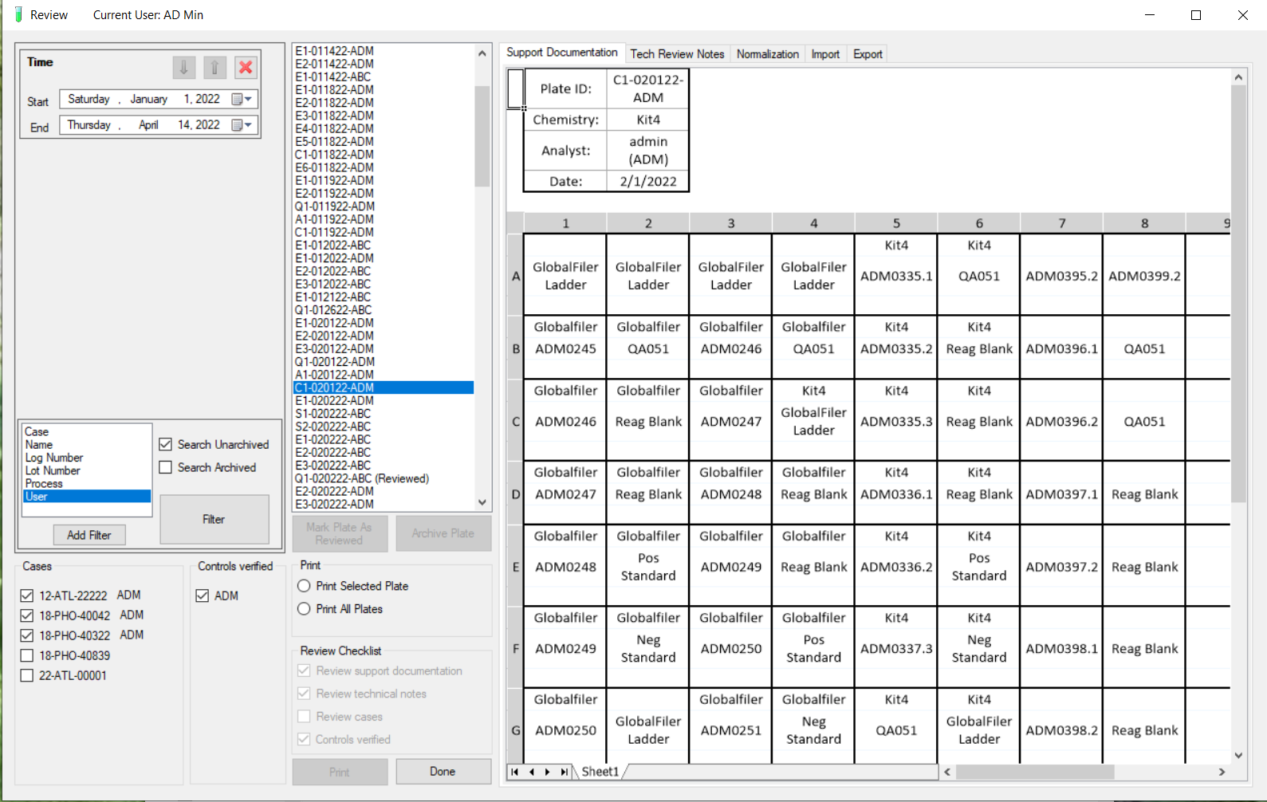
Support View for Tech Review

Slide 31
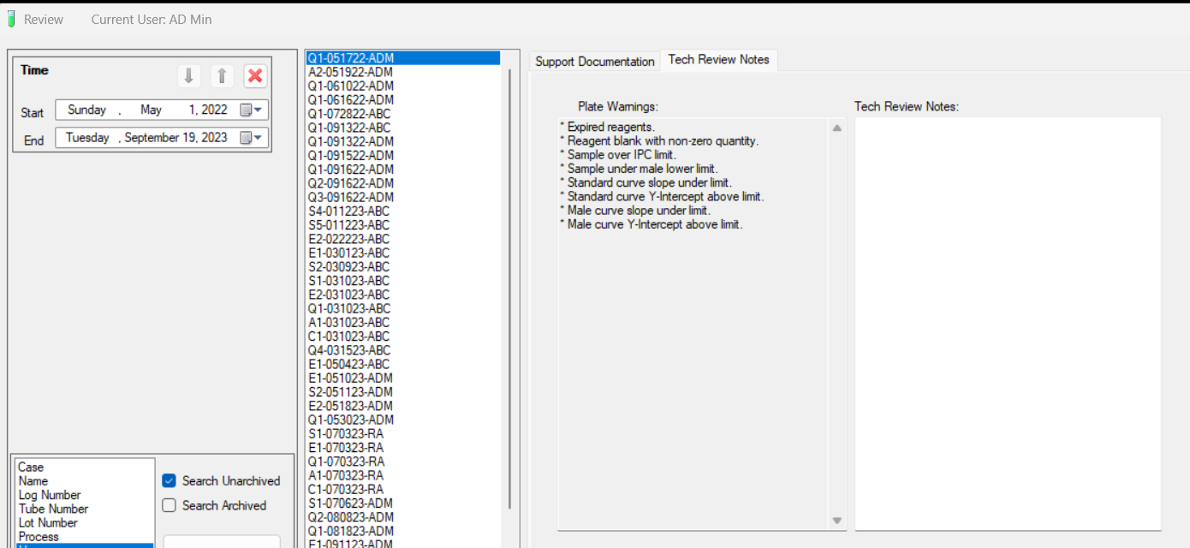

Slide 32
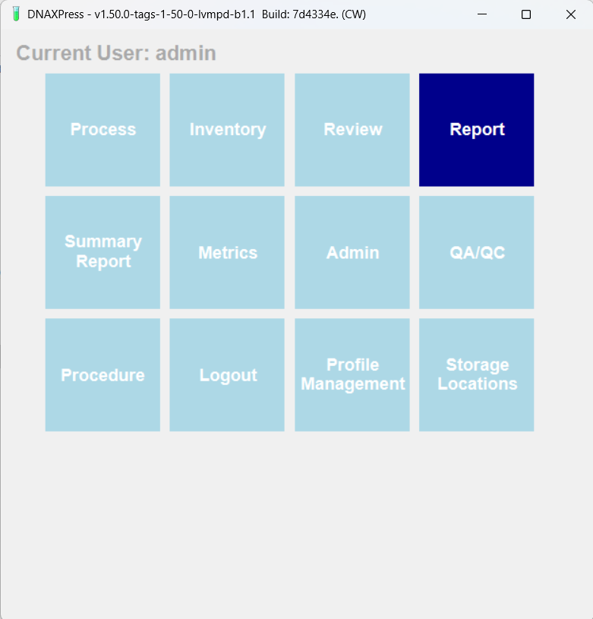

Slide 33
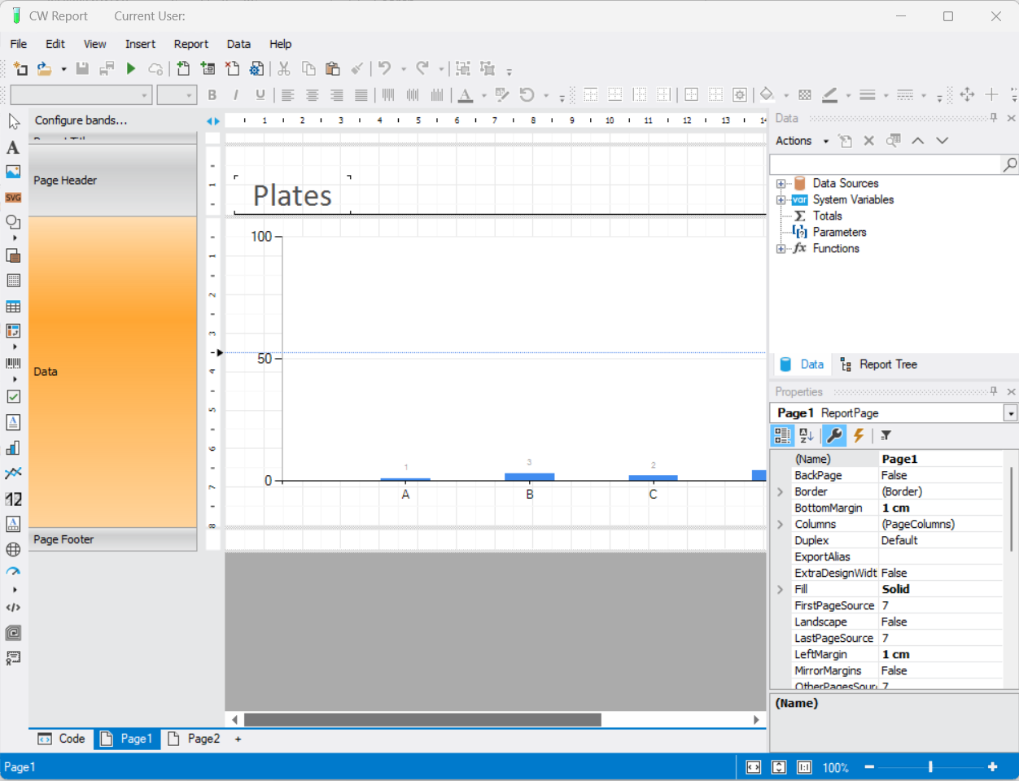
Customizable Report Designer

Slide 34
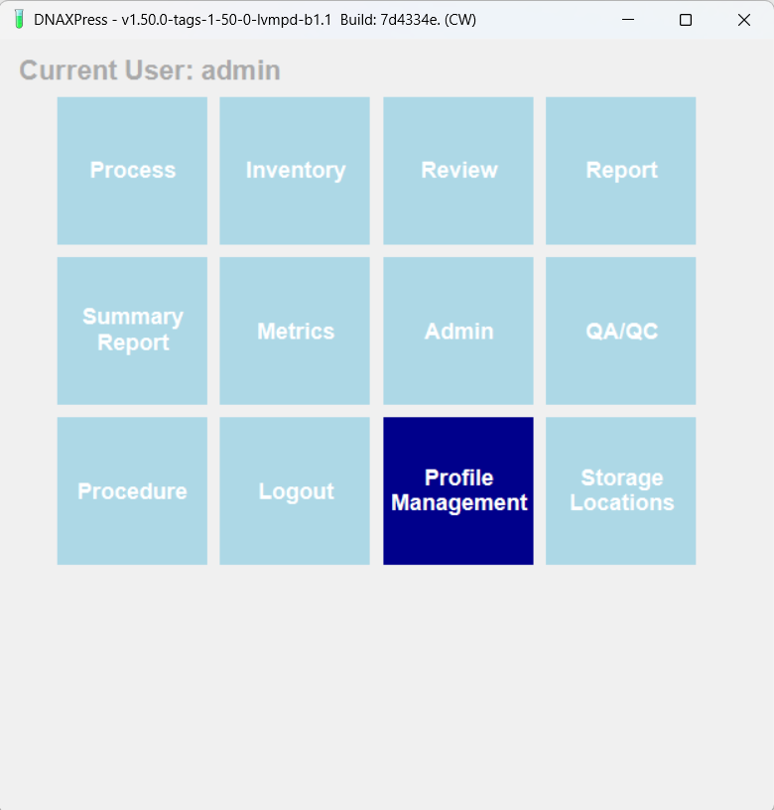

Slide 35
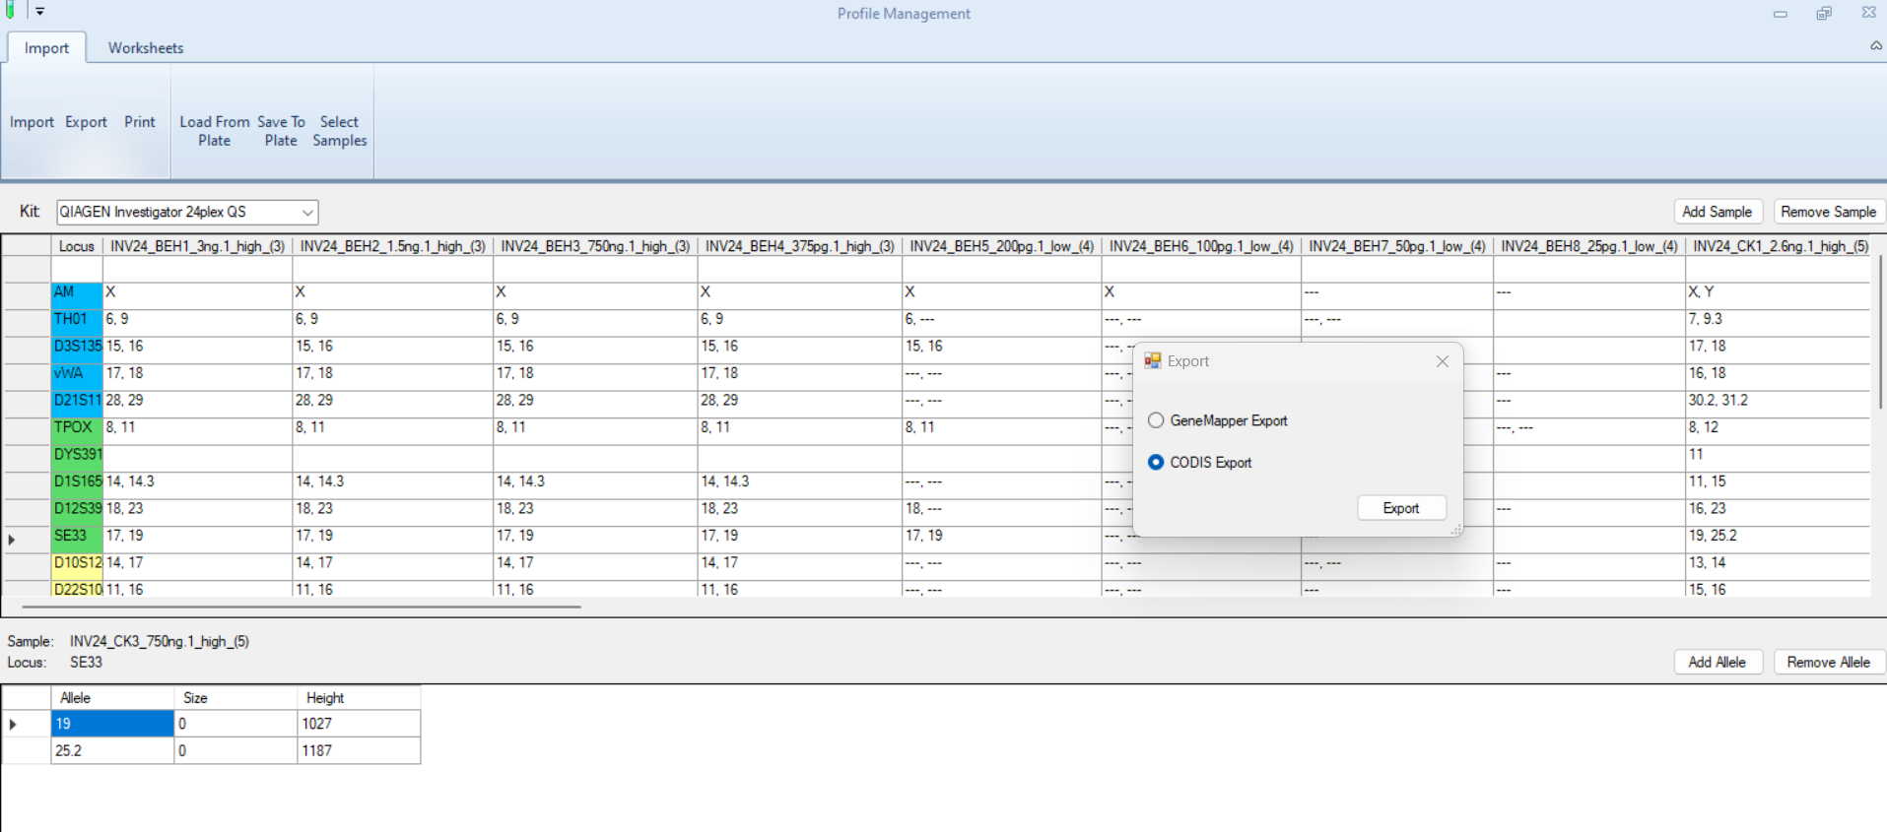
Profile Management

Slide 36
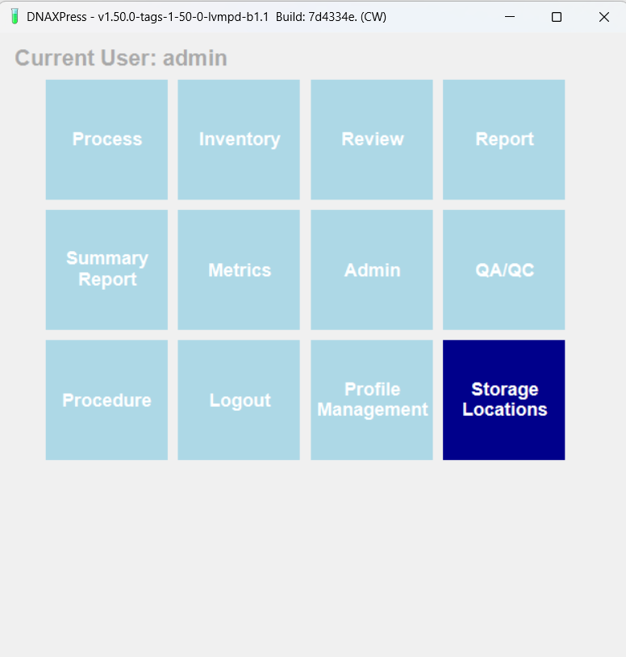

Slide 37
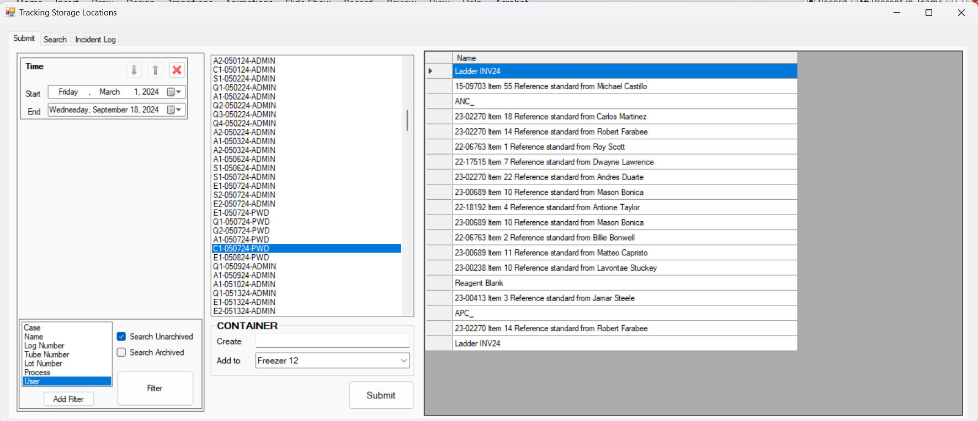

Slide 38
Thank You
? Questions ?

